Slide 1
WhisperComm: A Modern Communication Project
AI-Driven Speech Enhancement for AM Signals in Degraded Channels

Slide 2
PROBLEM & OBJECTIVES
Problem AM voice communications, though simple and widely used in aviation and maritime systems, degrade severely under noise. Traditional filters distort speech and fail under non-stationary conditions, making speech unintelligible for both humans and automated systems.
Objectives
Simulate a complete AM channel with realistic noise.
Apply state-of-the-art AI denoiser for post-demodulation enhancement.
Validate improvements objectively via Whisper ASR Word Error Rate (WER).

Slide 3
THE THREE PILLARS
Software-Defined Radio (SDR): Building radios in software rather than circuits.
1
Signal-to-Noise Ratio (SNR): The universal measure of signal quality against noise.
2
Artificial Intelligence (AI): Intelligent denoising and transcription for speech recovery.
3

Slide 4
METHODOLOGY OVERVIEW
Load clean speech (ground truth).
Modulate with 4 kHz carrier.
Inject pink noise at different SNR levels.
Demodulate using envelope detection (rectifier + low-pass).
Enhance with AI denoiser.
Evaluate intelligibility using Whisper ASR.

Slide 5

SIGNAL PROCESSING WORKFLOW
AM Modulation: generates the carrier-modulated signal.
Noise Generation: Pink noise synthesized via spectral shaping to reflect real-world interference.
Channel Simulation: Noise power adjusted to achieve exact SNR levels.
Demodulation:
Rectifier: $∣r\left(t\right)∣$
Low-pass filter (Butterworth, 3800 Hz cutoff) extracts envelope.
Result: A noisy baseline audio stream resembling real degraded AM speech.

Slide 6
IMPLEMENTATION SETUP
Software Environment:
Python 3 with Colab Notebook for modular, interactive workflow.
Core Libraries:
PyTorch: Loads pretrained AI denoiser.
Transformers/Datasets: Provides Whisper ASR and Librispeech source.
SciPy: Filtering and signal design.
Librosa: Visualization of speech waveforms and spectrograms.
NumPy: Core numerical computations.

Slide 7
AI MODELS USED
1. Speech Enhancement (DNS64):
Loaded via PyTorch, pretrained on massive noisy-clean datasets.
Likely U-Net/CRN architecture.
Function: Removes noise while preserving formant structures critical for intelligibility.
2. ASR Model (Whisper-large-v3):
Hugely robust ASR trained on 680k hours of audio.
Evaluates transcription accuracy before/after enhancement.
Metric: Word Error Rate (WER).

Slide 8
SIMULATION CODE SNIPPET
Core AI Enhancement Pipeline (PyTorch):
Convert noisy NumPy audio → PyTorch tensor.
Use torch.no_grad() to run inference efficiently.
Pass through DNS64 denoiser → obtain enhanced tensor.
Convert tensor back to NumPy for playback and evaluation.
This concise, GPU-accelerated pipeline makes AI enhancement real-time capable while ensuring reproducibility in academic and industrial contexts.

Slide 9
SPECTROGRAM EVIDENCE (NOISY)
At 12 dB SNR, the noisy baseline signal shows heavy corruption:
Clean speech spectrogram: Distinct formants and harmonic bands visible.
Noisy demodulated spectrogram: Broadband noise floor masks details, blurring speech cues.
The visual confirms why AM under noise is unintelligible and why traditional filters fail—non-stationary noise disrupts speech structure beyond recovery.

Slide 10
SPECTROGRAM EVIDENCE (ENHANCED)
AI Enhancement restores intelligibility at 12 dB SNR:
Noisy baseline: Dense noise obscures speech bands.
AI-enhanced spectrogram: Noise floor removed, dark background restored.
Clear formants and harmonics emerge, resembling clean reference.
This validates the AI denoiser’s learned capability to separate human speech features from disruptive noise patterns.

Slide 11
IMPLICATIONS & LIMITATIONS
Implications:
Revives legacy AM systems for modern automation.
Enables archival transcription of historical, noisy audio.
Increases safety in aviation, maritime, and emergency voice communications.
Limitations:
Pure simulation; no real-air recordings used.
Only pink noise tested; real-world multipath/fading unmodeled.
No subjective human evaluation (MOS, MUSHRA).

Slide 12
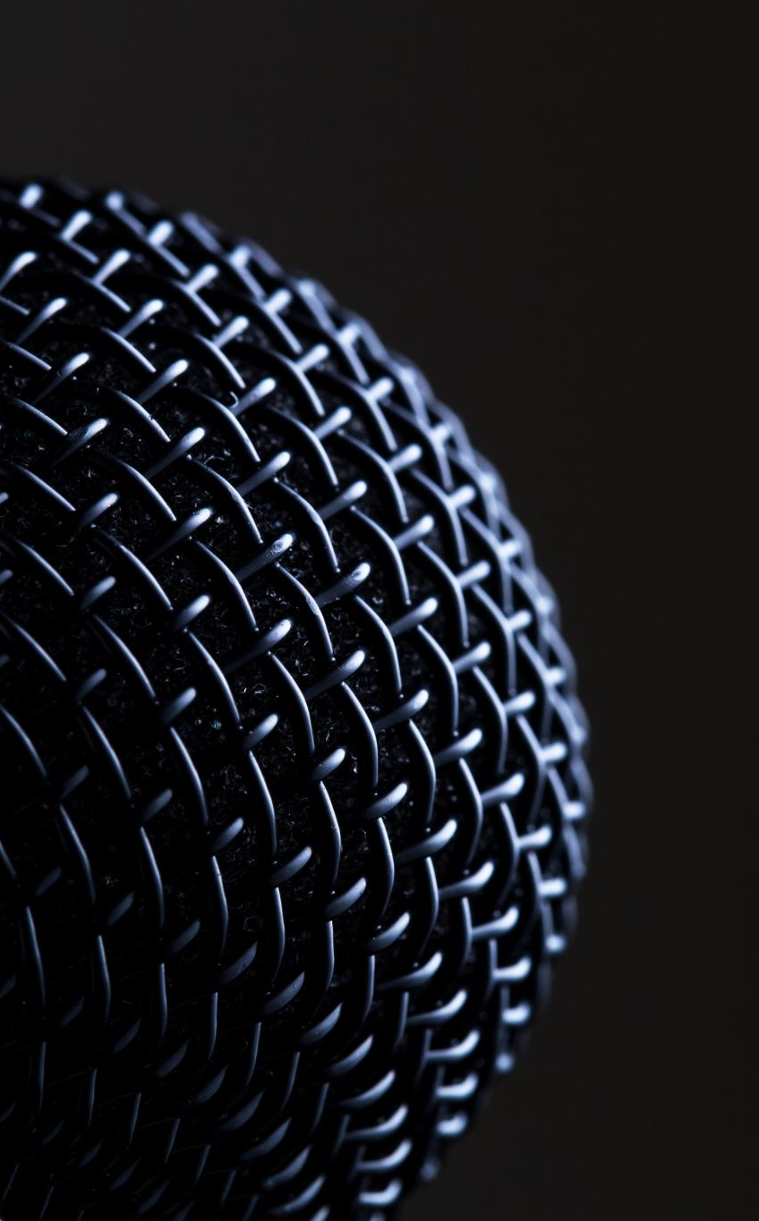
CONCLUSION & FUTURE WORK
Conclusion: The project proves AI-based denoising as a transformative solution for noisy AM speech, restoring intelligibility and enabling accurate ASR transcription across degraded channels.
Future Work:
Validate with real-world AM recordings.
Test broader languages, speakers, and noise types.
Include subjective quality tests (MOS, listening panels).
Optimize AI for real-time deployment on embedded systems.

